Slide 1


NIE Institute of Technology, Mysore
Approved by AICTE , New Delhi | Affiliated to VTU ,Belagavi
DEPARTMENT OF ELECTRONICS AND COMMUNICATION ENGINEERING
Project Presentation on
“IntelliSense Toll Management System Automatic Vehicle Plate Recognition for Identity-Based Transactions”
UNDER THE GUIDENCE OF
Mrs. Pushpalatha H P
Assistant Professor
Dept. of Electronics & Communication
NIEIT, Mysuru.
Team Members
ABIN CHACKO (4NN20EC002)
KARAN S (4NN20EC013)
MOHAMMED JUNAID (4NN20EC022)
PHANEENDRA M V (4NN20EC025)

Slide 2

CONTENTS
Introduction
Problem Statement and Objectives
Literature Survey
Block Diagram
Circuit Diagram
Hardware Requirements
Software Implementation
Flowchart
Explanation
Result
Advantages and Applications
Future Scope
Conclusion
Reference

Slide 3
INTRODUCTION
IntelliSense Toll Management System uses Node MCU microcontroller for seamless communication between hardware and software, enhancing agility and scalability of toll collection operations.
Integration of ultrasonic sensors and ESP32 camera modules enables accurate vehicle detection and high-resolution image capture for automated license plate recognition, streamlining toll collection processes.
Image processing algorithms like OpenCV and Tesseract OCR extract license plate information, facilitating automated billing and notification processes linked to registered email addresses, promoting user convenience and transparency.
By automating toll collection and reducing manual errors, the system improves traffic flow, enhances road safety, and enables authorities to make informed decisions regarding infrastructure planning and revenue allocation.
Embracing emerging technologies and a user-centric approach, the project aims to revolutionize toll management, paving the way for smarter, more connected transportation systems while reducing fuel consumption and alleviating traffic congestion.

Slide 4
PROBLEM STATEMENT
To Develop an efficient Toll Management System that leverages image processing to identify the vehicle’s license number and address the inefficiencies in manual toll collection, reduce traffic congestion, enhance commuter’s productivity, and reduce fuel wastage.
OBJECTIVES
Develop a robust ANPR system that can accurately and efficiently recognize vehicle license plates using digital image processing techniques.
Implement a secure and efficient transaction system that links recognized vehicle plates to user identities, ensuring seamless toll collection and management based on the vehicle owner's account.
Achieve real-time processing of vehicle plate recognition and transaction handling to minimize toll booth waiting times and enhance overall system responsiveness.
Ensure compatibility and integration with existing toll booth infrastructure, allowing for a smooth transition and adoption of the IntelliSense Toll Management System without major disruptions.

Slide 5
LITERATURE SURVEY
Ref-Year of Publication | Article title | Key findings
2022 | "Intelligent Toll Collection System for Moving Vehicles in India" | Integration of OCR technology automates toll collection, improving efficiency and reducing congestion at toll booths, advancing transportation systems in India.
2021 | "Automated Number Plate Recognition System". | Integration of ANPR and OCR technologies enhances identification accuracy, offering potential in traffic management and law enforcement.
2020 | "Image-Preprocessing and Segmentation Techniques for Vehicle-Plate Recognition" | Novel preprocessing and segmentation methods optimize accuracy and reliability of vehicle plate recognition systems.

Slide 6
Block Diagram
Power Supply
+
-
-
-
+
Ultrasonic Sensor
(HC-SR04)
Local Server
Node MCU
ESP32
Camera module
Fig 1. Block Diagram of ANPR System.

Slide 7
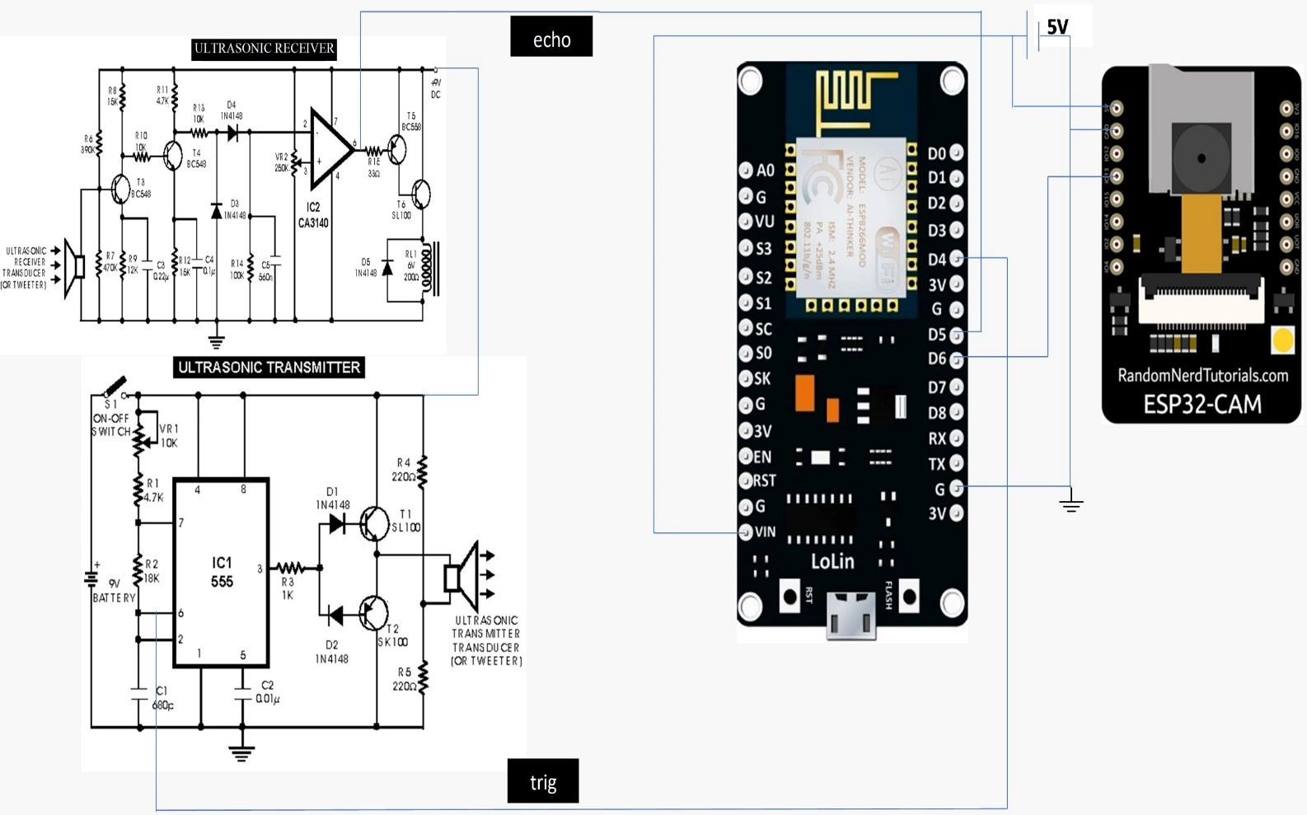
CIRCUIT DIAGRAM
Fig 2. circuit Diagram

Slide 8
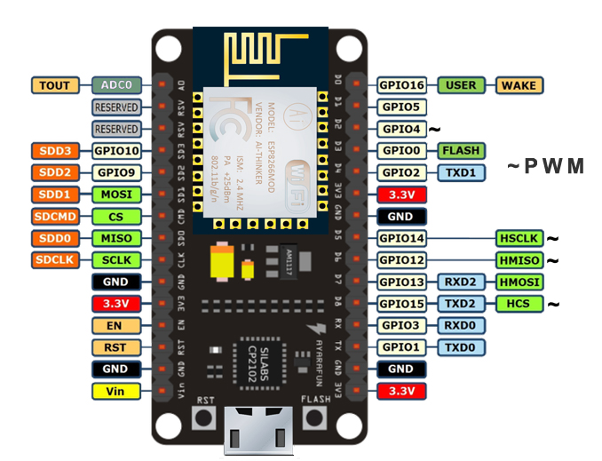
HARDWARE IMPLEMENTATION
NODE MCU MICROCONTROLLER- The Node MCU serves as the backbone of the toll management system, boasting a robust architecture and versatile connectivity options to facilitate seamless communication and control within the system. Operates at 5V and Regulated 3.3V output for external components.
Fig 3. Node MCU Microcontroller.

Slide 9
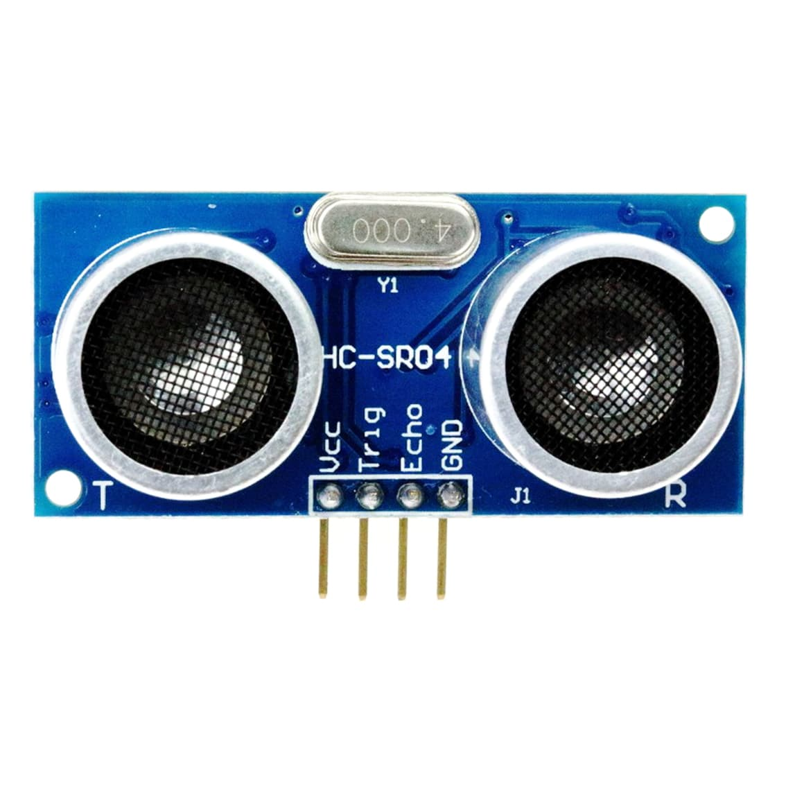
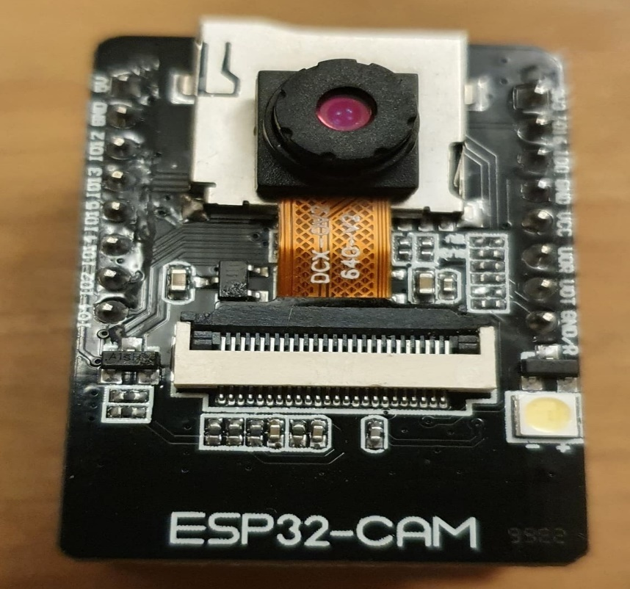
HC-SR04 Ultrasonic Sensor - Operating on the principle of emitting ultrasonic waves and measuring the time taken for the echo to return, the sensor detects the presence of a vehicle within its specified range.
Operates at 5v. Current 10mA.
ESP32 CAMERA MODULE - Captures high-resolution images of the vehicle's number plate. Operates at 5v. Resolution 160x120 to 1600x1200 pixels based on project requirements Interfaces with the Node MCU microcontroller through D6 GPIO pin.
Fig 4. HC-SR04 Ultrasonic Sensor .
09-05-2024
Fig 5. ESP32 camera module

Slide 10

Local Server - The laptop employed as the server, or local host, in the Automatic Number Plate Recognition (ANPR) project plays a pivotal role in processing and storing captured images. This server, typically running Python, OpenCV, Tesseract OCR, and Serves as the backend infrastructure for image processing and database management.
Fig 6. Local server.

Slide 11
SOFTWARE IMPLEMENTATION
Arduino IDE for Node MCU – To program Node MCU, the Arduino IDE serves as the development environment for writing and uploading firmware to the Node MCU microcontroller.
Python - On the server side, Python plays a pivotal role, leveraging popular libraries such as
OpenCV/ TensorFlow for image processing and Tesseract OCR for optical character recognition.
OpenCV facilitates tasks like image capture and feature extraction.
Tesseract OCR extracts alphanumeric characters from the identified number plate regions.

Slide 12
Flowchart
Start.
No
Sense Vehicle approaching?
Yes
Image Acquisition
Using ESP32 camera module and uploading it to Google drive.
Image downloading, cropping, contrast enhancement and image processing.
Characters Segmentation using
R-CNN and character recognition using tesseract OCR (text extraction).
CON

Slide 13
CON
license text
found matched against the registered
Email-id?
No
License number is flagged for manual intervention
Yes
Generation of Bill and sending it to Mail-id of the vehicle owner.
End.
Fig 7. Flowchart

Slide 14
EXPLAINATION
The circuit connection for the Automatic Number Plate Recognition (ANPR) project using the Node MCU involves the integration of various components to create a seamless and intelligent system.
At the core of the circuit is the Node MCU microcontroller, serving as the brain of the project.
The Node MCU is connected to an ultrasonic sensor, responsible for detecting the approach of a vehicle. The ultrasonic sensor, typically interfaced with GPIO pins on the Node MCU, provides real-time data on the distance of the vehicle, triggering the subsequent steps in the ANPR process
In conjunction with the ultrasonic sensor, an ESP32 camera module is connected to the Node MCU to capture images of the vehicle's number plate upon detection.
The camera module, communicating with the Node MCU through the Serial Camera Control Bus (SCCB), ensures accurate image capture for subsequent processing.
Optionally, an SD card module can be integrated into the circuit to store captured images for further analysis.

Slide 15
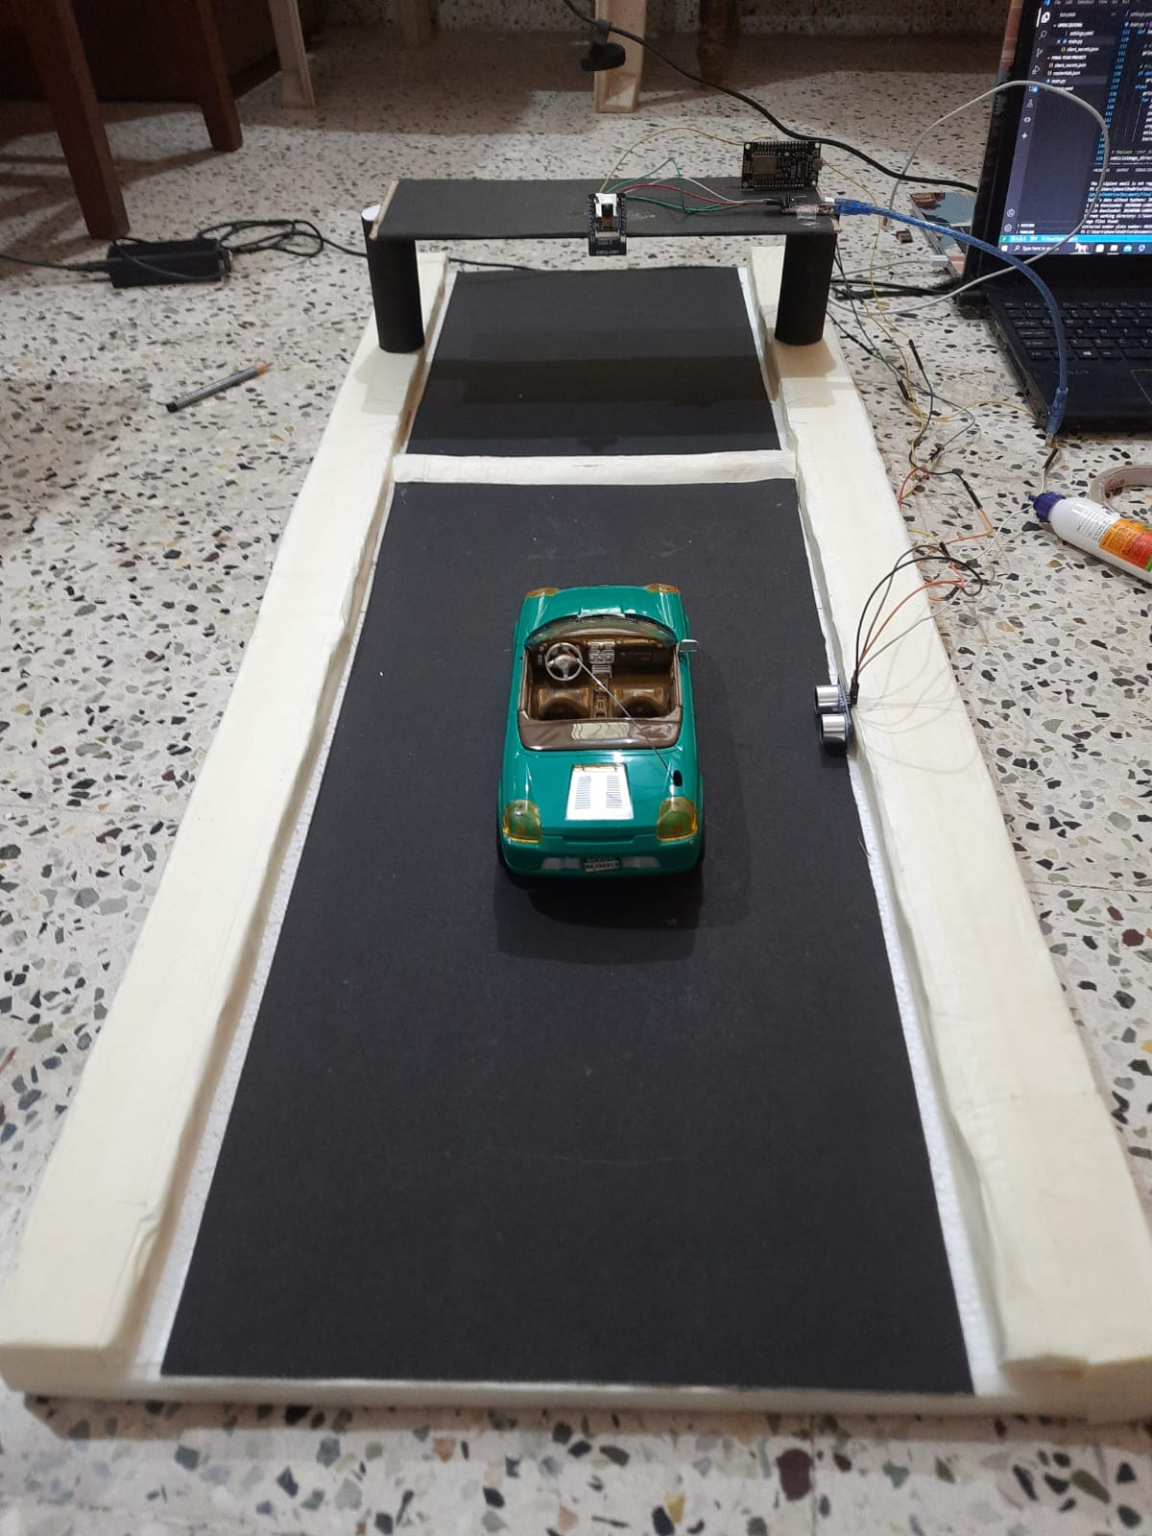
Result
Fig 8. Model of the Toll management system.

Slide 16
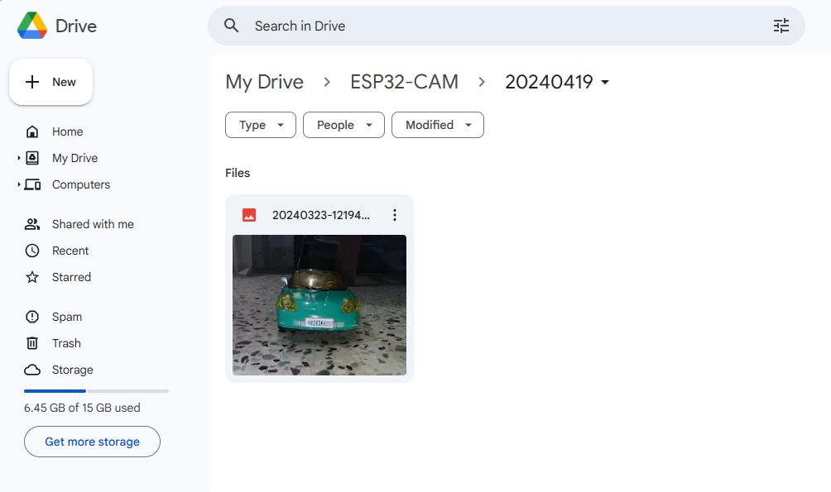
Fig 9. Captured Image Uploaded to Google Drive

Slide 17
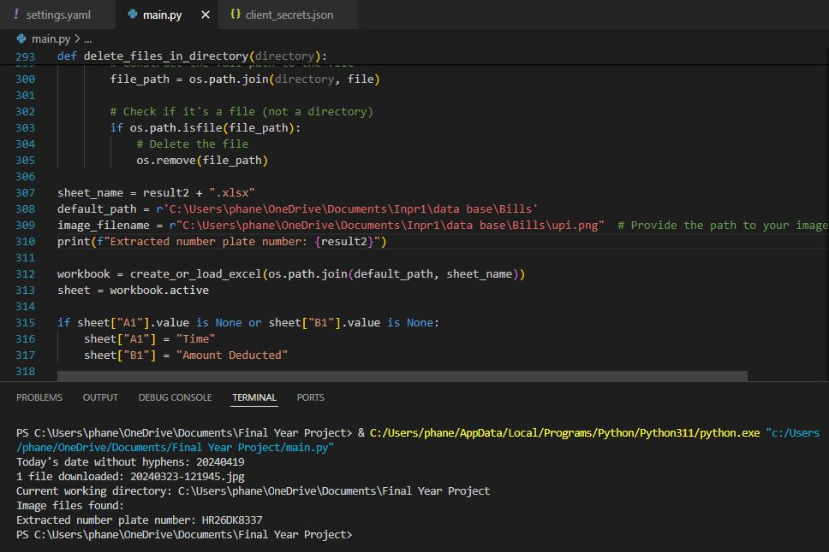
Fig 10. Image processed and License Text recognized.

Slide 18
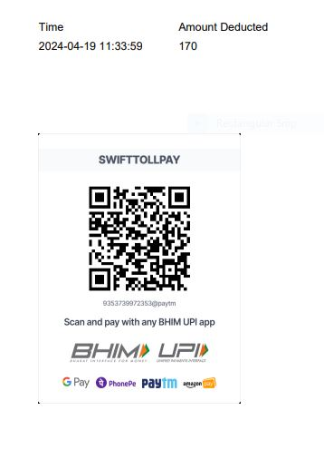
Fig 11. Bill generated in PDF Format

Slide 19
ADVANTAGES
Efficient and Automated Vehicle Identification.
Enhanced Security.
Improved Traffic Management.
Reduced Manual Workload.
Real-time Monitoring.
Accurate Data Collection.
Seamless Parking Solutions.
Increased Fuel Efficiency.

Slide 20
DRAWBACKS
Database accuracy: The system relies on an accurate and up-to-date database of license plates and corresponding email addresses. Inaccurate data can lead to sending bills to the wrong email addresses.
Unauthorized access: The system should be protected against unauthorized access that could manipulate data or disrupt operations. Authentication mechanisms must be implemented for the server-side application.
Hardware malfunctions: Component failures (NodeMCU, camera, or server) can disrupt operation. Consider redundancy measures for critical components.

Slide 21
APPLICATIONS
Smart Cities.
Access Control and Security.
Traffic Monitoring and Optimization.
Border Control and Customs.
Logistics and Fleet Management.

Slide 22
FUTURE SCOPE
Nationwide Implementation Potential
Revenue Optimization Opportunities
Alignment with Smart City Goals
Job Creation and Skill Development
Enhanced Commuter Experience

Slide 23
CONCLUSION
The ANPR project, utilizing Node MCU, ultrasonic sensors, and ESP32 camera module, advances intelligent transportation and security. Seamlessly capturing vehicle data, Node MCU coordinates sensor and camera functions for precise detection. Additional components like LEDs and optional SD card modules enhance user-friendliness. Integration with Google Script and Drive API enables server connectivity for image processing. Python, OpenCV, and Tesseract OCR power the server for data extraction. ANPR demonstrates smart technology's potential in traffic management and surveillance. Built on Node MCU, it paves the way for future innovations in intelligent systems.

Slide 24
REFERENCES
Rajeev Kumar Chauhan, Kalpana Chauhan – “Intelligent toll collection system for moving vehicles in India”
Mohamed Alkalai , Ahmed Lawgali -“ Image-Preprocessing and Segmentation Techniques for Vehicle Plate Recognition”
Emina E. Etomi and Donatus. U. Onyishi – “Automated number plate recognition system” Mahmoud El Hendy , Shadi Atalla , Sami Miniaoui , Mohammad Daradkeh and Wathiq Mansoor and Kamarul Faizal Bin Hashim – “Hybrid Approach for Developing Strategic ICT Framework for Smart Cities”.
Seong-In Kang, Sang-cheol Byun, Yeo-Han Yoon, - “Study on Single Camera Based ANPR System for Improvement of Vehicle Number Plate Recognition on Multi- Lane Roads”.

Slide 25

QUESTIONNAIRE

Slide 26
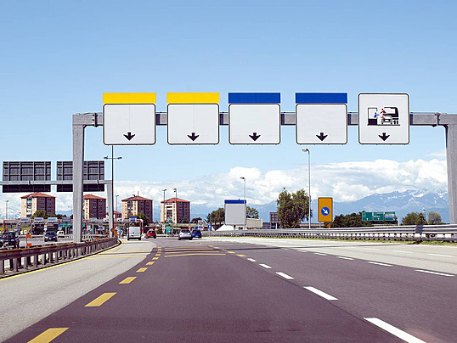
A K J P
THANK
YOU !

